Slide 1
TRAILS: a phylogenetically aware SMC to infer the evolutionary history of species
Iker Rivas-González

Slide 2
Overview
Incomplete lineage sorting (ILS)
HMMs: CoalHMM and SMCs
TRAILS
The hidden states
The CTMCs
The transition probability matrix
Simulating from the model
Discussion

Slide 3
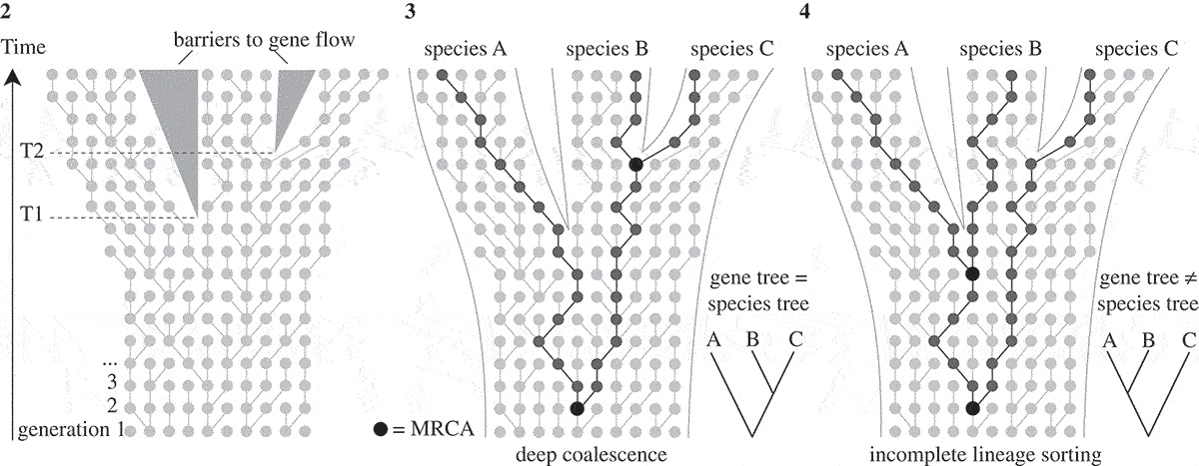
Incomplete lineage sorting (ILS)
Modified from Leliaert et al. (2013)
Notes:
- Three species, two speciation events.
- If 1st coal between T1 and T2 -> gene tree = species tree
- If 1st coal escapes T2 -> maybe gene tree != species tree
- This is called ILS.
- Usually regarded as an obstacle for phylogenetic reconstruction.
- But valuable -> information-rich about speciation times and ancestral population sizes.

Slide 4
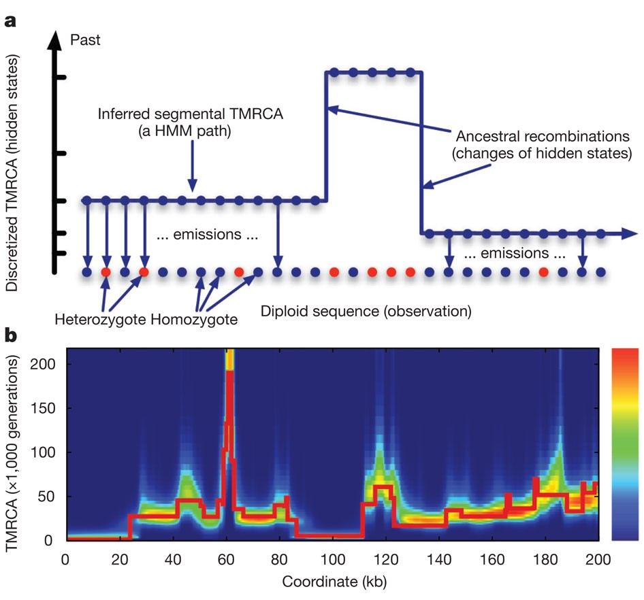
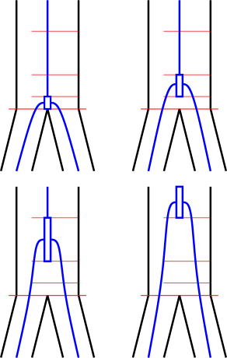
HMMs
SMCs
Li and Durbin (2011)
Notes:
- Sequentially Markovian coalescents
- Hidden states are discretized time intervals.
- Useful to model changes in Ne through time.
- Drawback: only one coalescent.
- CoalHMM:
-hidden states are phylogenetic trees
- V0: canonical topology
- V1, V2, V3: the others deep coalescence
- V2, V3: alternative topologies (ILS).
- Useful to infer spec times & ancestral Ne.
- Drawback: biased parameters.

Slide 5
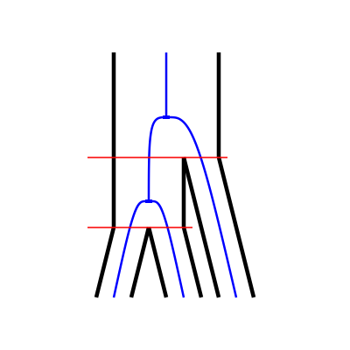
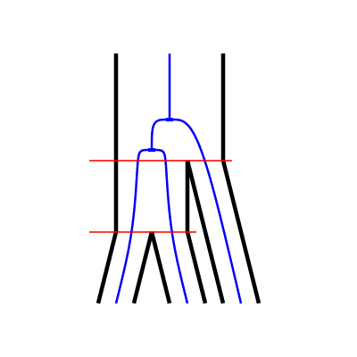
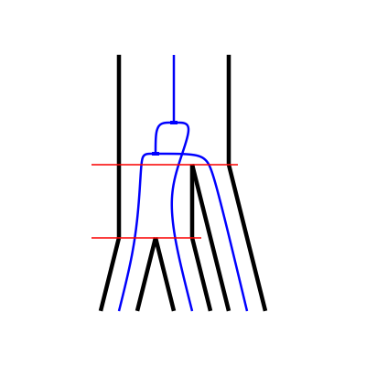
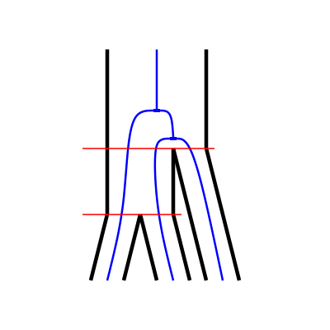
HMMs
V0
V1
CoalHMM
SMCs
V2
V3
Notes:
- Sequentially Markovian coalescents
- Hidden states are discretized time intervals.
- Useful to model changes in Ne through time.
- Drawback: only one coalescent.
- CoalHMM:
-hidden states are phylogenetic trees
- V0: canonical topology
- V1, V2, V3: the others deep coalescence
- V2, V3: alternative topologies (ILS).
- Useful to infer spec times & ancestral Ne.
- Drawback: biased parameters.

Slide 6
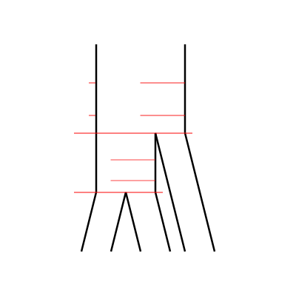
ILSMC
Extract the ILS information CoalHMM-style
Parameterize with discretized time intervals SMC-style
Notes:
- Combine the two approaches.

Slide 7
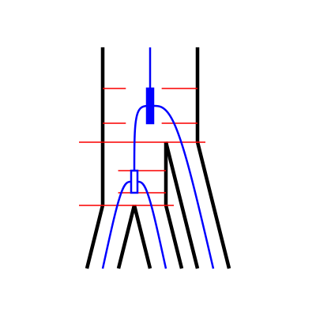
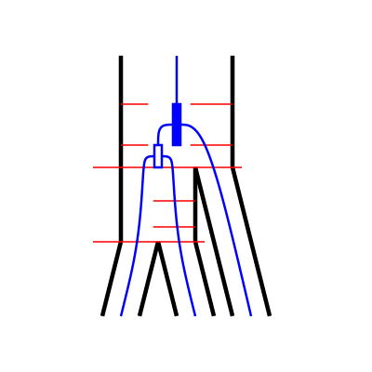
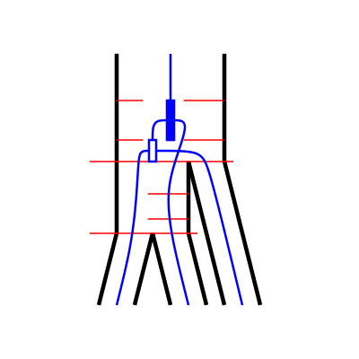
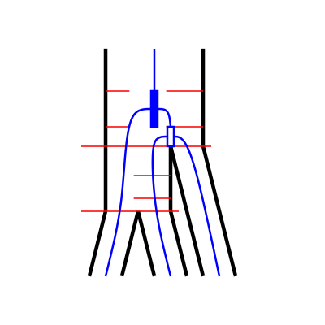
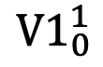
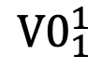
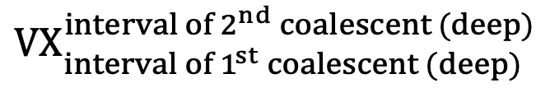
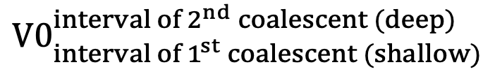
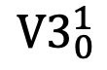
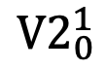
The hidden states
$${V0}_{1}^{1}$$
$${V1}_{0}^{1}$$
$${V2}_{0}^{1}$$
$${V3}_{0}^{1}$$
2
2
2
2
Deep
1
Deep
1
Deep
1
Deep
1
0
0
0
0
2
2
2
2
Shallow
Shallow
Shallow
Shallow
1
1
1
1
0
0
0
0
$${V0}_{{interval of 1}^{st} coalescent (shallow)}^{{interval of 2}^{nd} coalescent (deep)}$$
$${VX}_{{interval of 1}^{st} coalescent (deep)}^{{interval of 2}^{nd} coalescent (deep)}$$
Notes:
- New hidden states: phylogenetic trees with two discretized coalescent events.
- V0 -> set of V0 states, each with a combination of coal times.

Slide 8
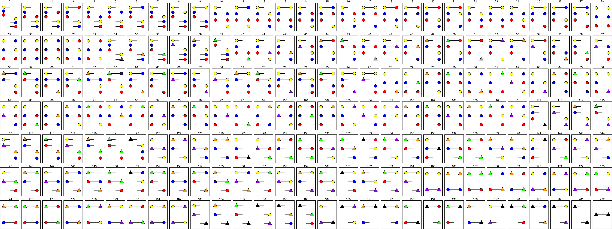
The CTMCs
Three-sequence CTMC
Two-sequence CTMC
One-sequence CTMC
One-sequence CTMC
One-sequence CTMC
Notes:
- ILSMC is built by interconnected CTMCs (continuous-time Markov chains).
- These are needed to get the transition probability matrix of ILSMC.

Slide 9
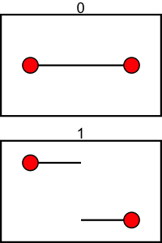
The CTMCs
1C
1R

Slide 10
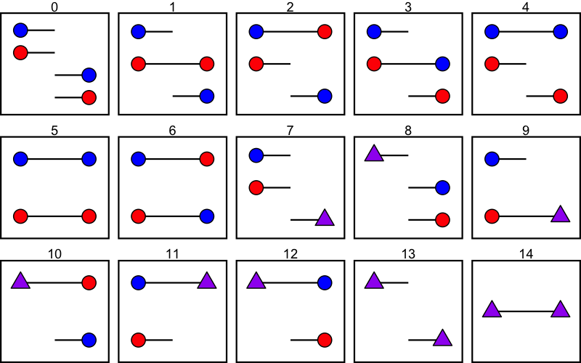
The CTMCs

Slide 11
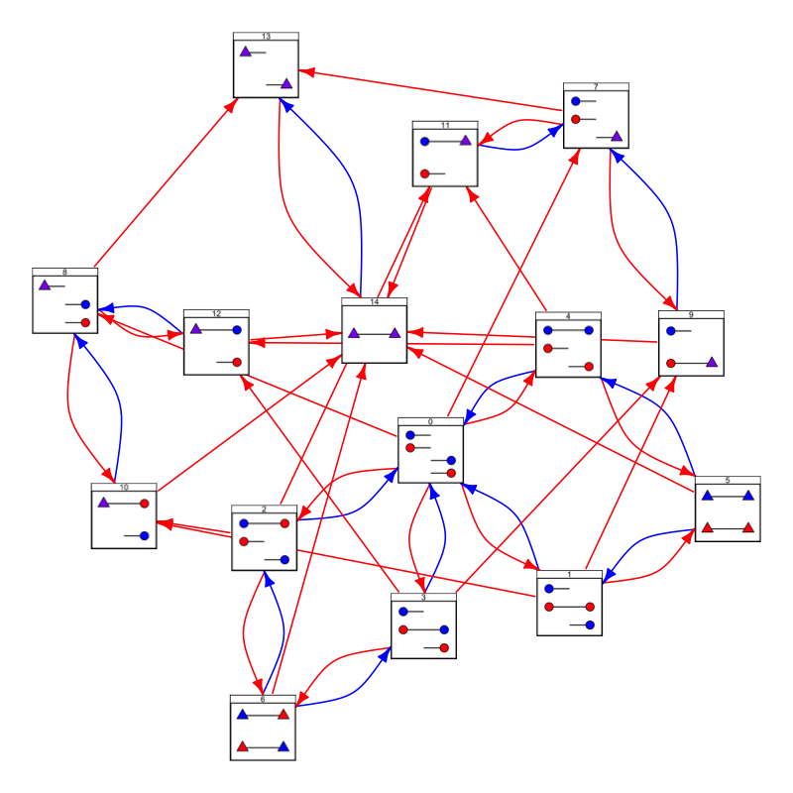
The CTMCs

Slide 12
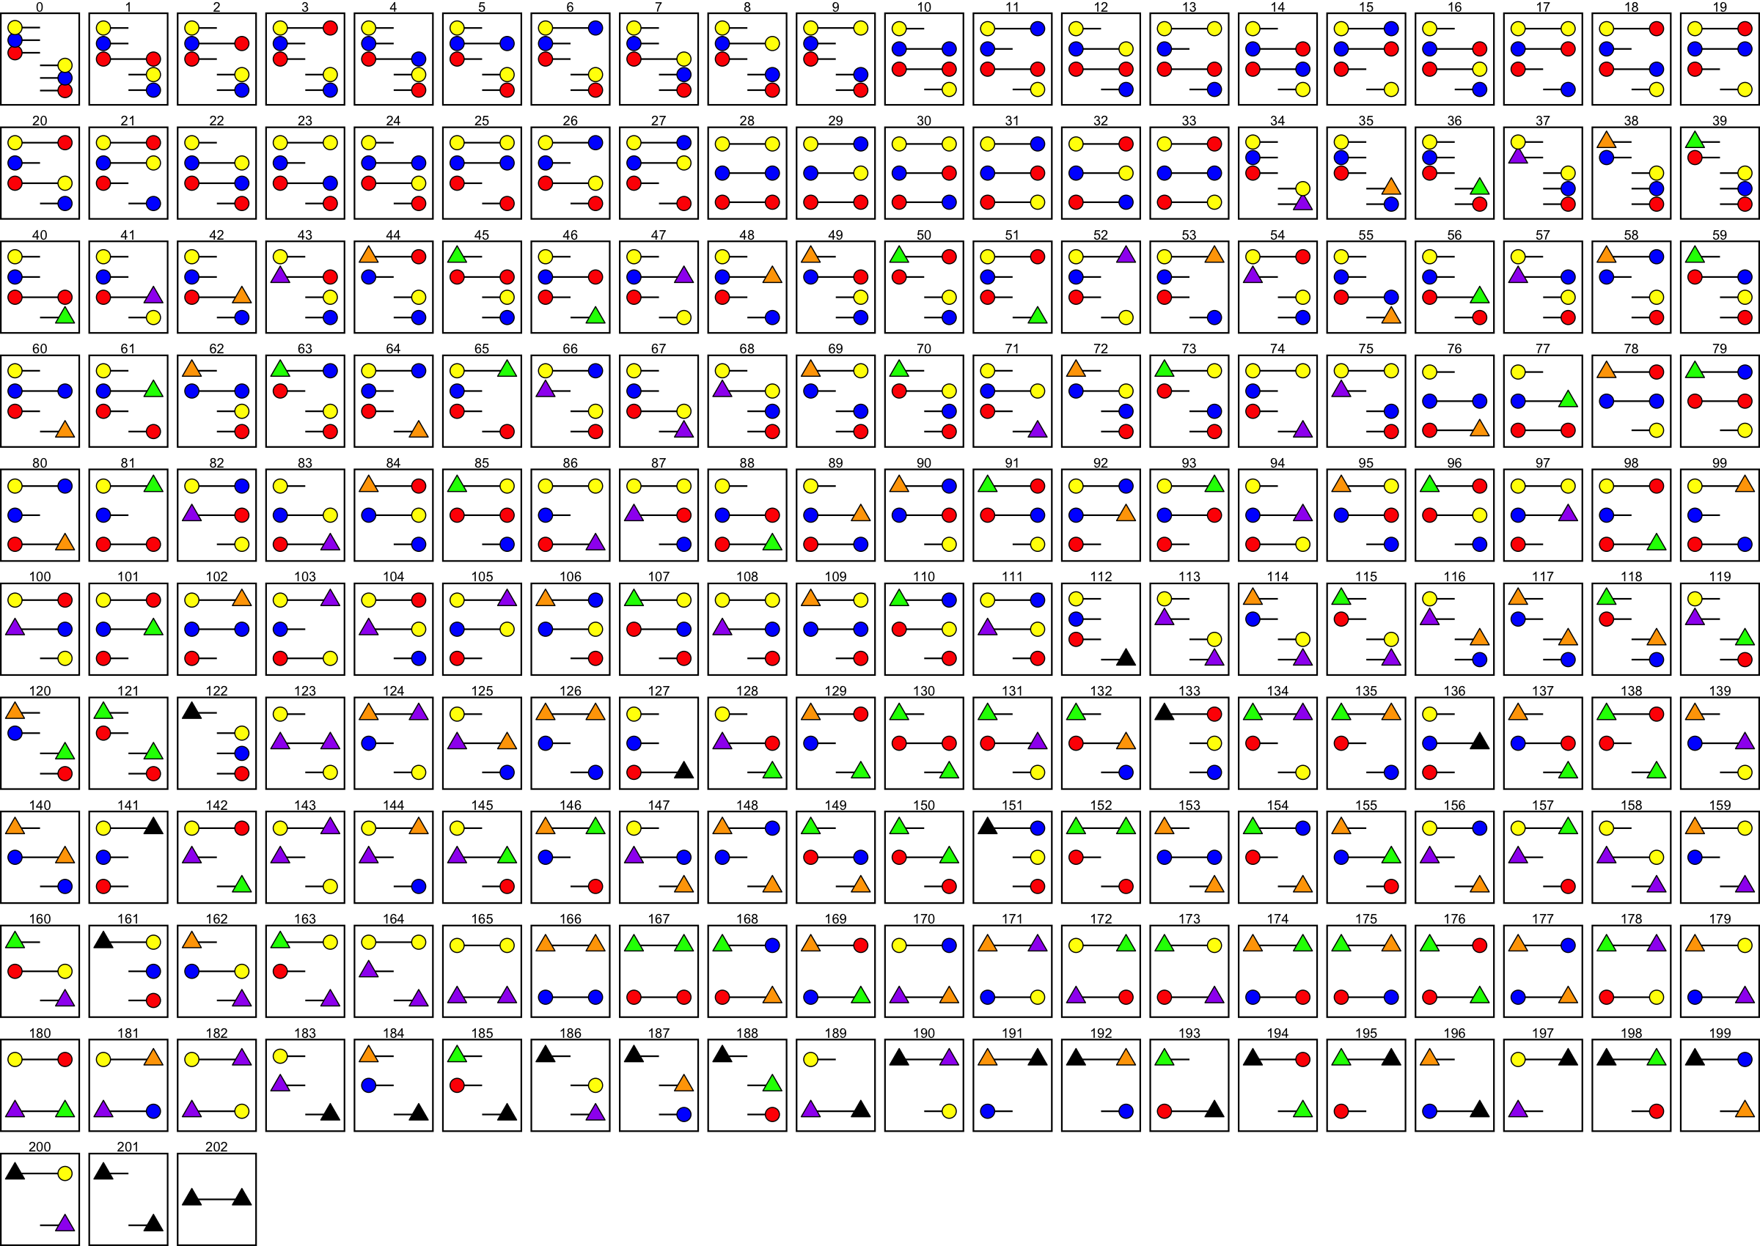
The CTMCs

Slide 13
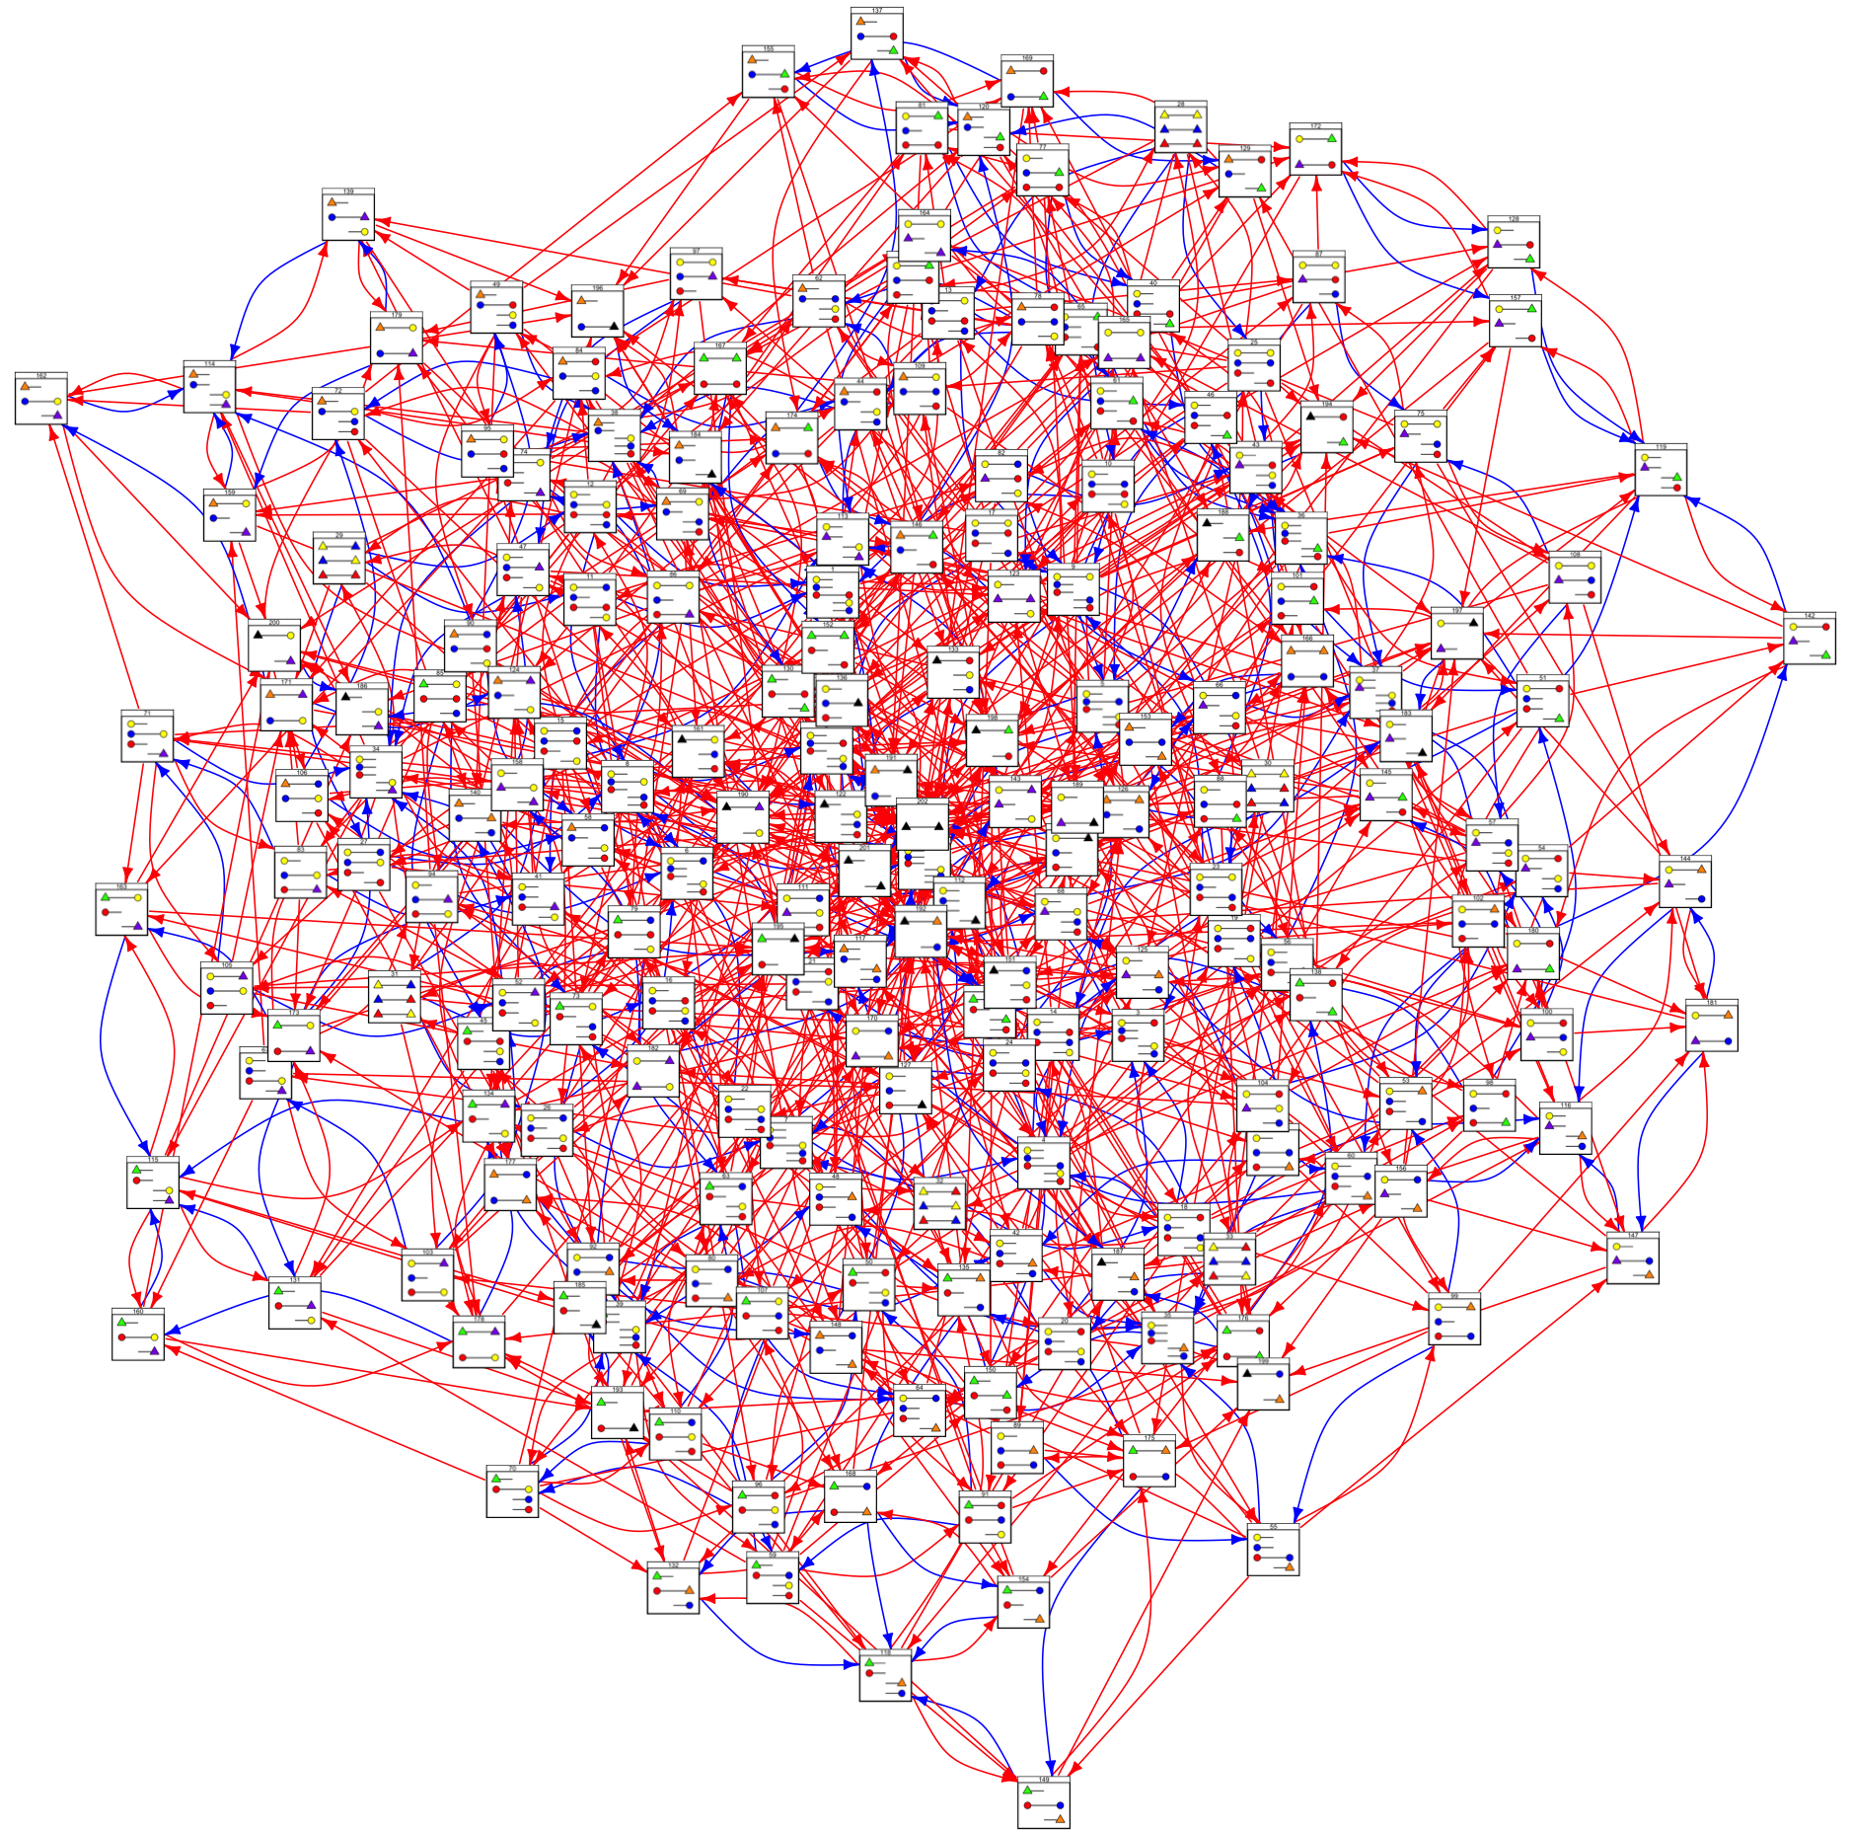
The CTMCs

Slide 14
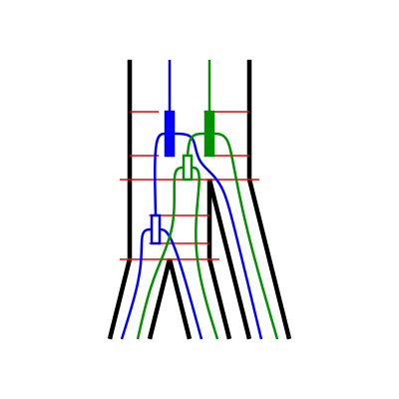
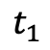
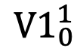

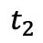
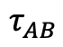
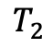
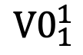

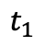
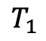
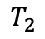
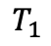
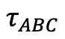
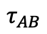
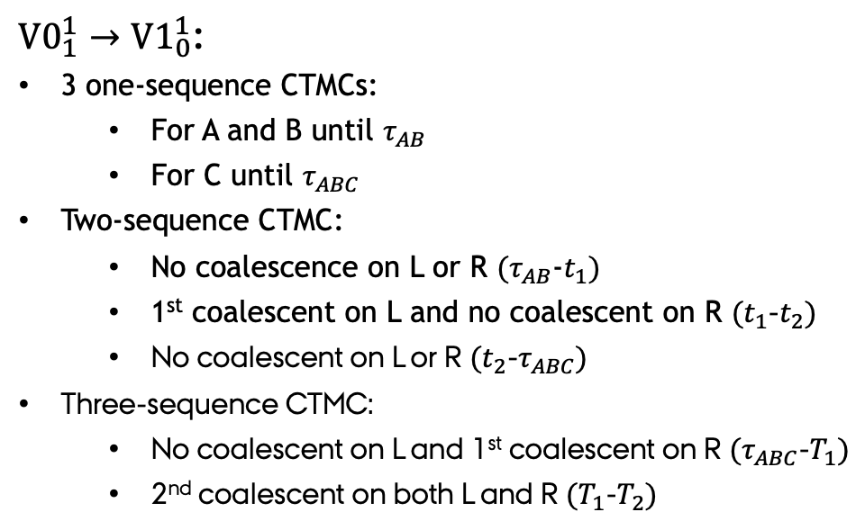
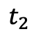
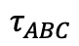
The transition probability matrix
Right site
${V1}_{0}^{1}$
Left site
Right site
Left site
$${V0}_{1}^{1}$$
${V0}_{1}^{1}→{V1}_{0}^{1}$:
3 one-sequence CTMCs:
For A and B until $τ_{AB}$
For C until $τ_{ABC}$
Two-sequence CTMC:
No coalescence on L or R $(τ_{AB}$-$t_{1})$
1st coalescent on L and no coalescent on R $(t_{1}$-$t_{2})$
No coalescent on L or R $(t_{2}$-$τ_{ABC})$
Three-sequence CTMC:
No coalescent on L and 1st coalescent on R $(τ_{ABC}$-$T_{1})$
2nd coalescent on both L and R $(T_{1}$-$T_{2})$
$${V0}_{1}^{1}$$
$${V1}_{0}^{1}$$
$$T_{2}$$
$$T_{2}$$
$$T_{1}$$
$$T_{1}$$
$$τ_{ABC}$$
$$τ_{ABC}$$
$$t_{2}$$
$$t_{2}$$
$$t_{1}$$
$$t_{1}$$
$$τ_{AB}$$
$$τ_{AB}$$

Slide 15
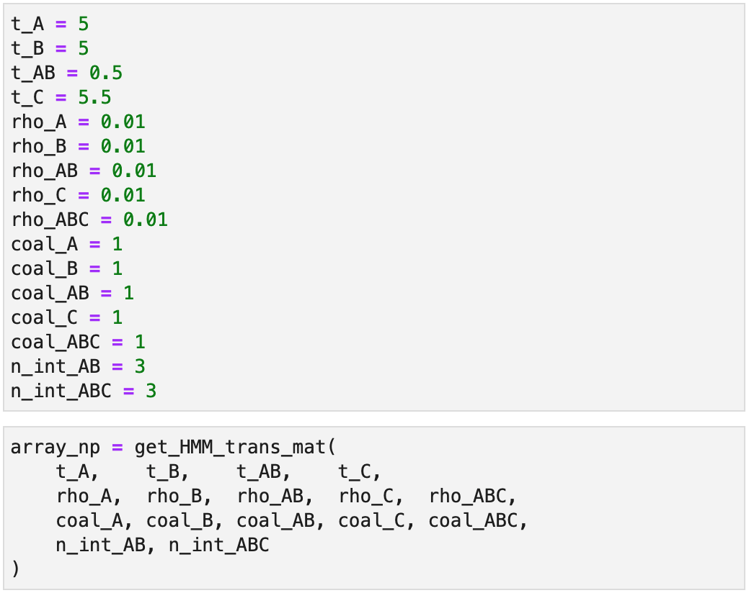
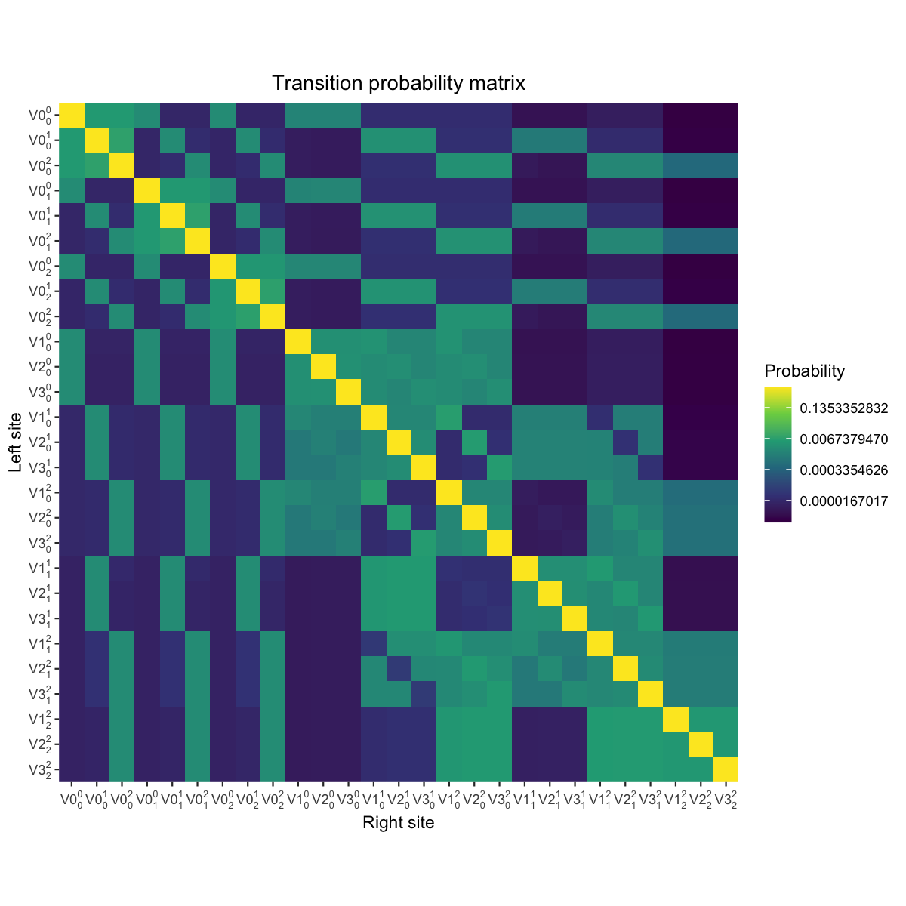
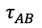
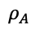
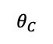
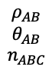
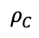
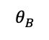
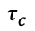
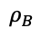




The transition probability matrix
$$ρ_{ABC}$$
$$θ_{ABC}$$
$$n_{ABC}$$
$$ρ_{AB}$$
$$θ_{AB}$$
$$n_{ABC}$$
$$τ_{AB}$$
$$ρ_{C}$$
$$θ_{C}$$
$$τ_{c}$$
$$τ_{A}$$
$$ρ_{A}$$
$$ρ_{B}$$
$$τ_{B}$$
$$θ_{A}$$
$$θ_{B}$$

Slide 16

Simulating from the model

Slide 17

Simulating from the model
$${V0}_{0}^{0}$$

Slide 18

Simulating from the model
$${V3}_{0}^{1}$$

Slide 19
Discussion
Current state:
Transition probability matrix calculated

Slide 20
Discussion
Current state:
Transition probability matrix calculated
Future work:
Optimize transition probability matrix
Emission probabilities.
Chose and code optimization procedure
Analyze simulated data

Slide 21
Discussion
Current state:
Transition probability matrix calculated
Future work:
Optimize transition probability matrix
Emission probabilities.
Chose and code optimization procedure
Analyze simulated data
Future perspective:
ILSMC is flexible:
Different parameterization per interval
ILSMC is extensible:
ILS and introgression

Slide 22







Acknowledgements
References
Dutheil, J. Y., Ganapathy, G., Hobolth, A., Mailund, T., Uyenoyama, M. K., & Schierup, M. H. (2009). Ancestral population genomics: the coalescent hidden Markov model approach. Genetics, 183(1), 259-274.
Mailund, T., Dutheil, J. Y., Hobolth, A., Lunter, G., & Schierup, M. H. (2011). Estimating divergence time and ancestral effective population size of Bornean and Sumatran orangutan subspecies using a coalescent hidden Markov model. PLoS genetics, 7(3), e1001319.
Li, H., & Durbin, R. (2011). Inference of human population history from individual whole-genome sequences. Nature, 475(7357), 493-496.
Mikkel H. Schierup
Asger Hobolth
Contact
Julien Y. Dutheil
Iker Rivas-González – PhD Student
Bioinformatics Research Centre (BiRC)
Aarhus University
irg@birc.au.dk @irg_bio
t11-rivas-gonzález-phylogenetically
My colleagues at BiRC

